Slide 1
Next Generation Databases NoSQL, NewSQL, and Big Data Guy Harrison
Chapter 1: Three Database Revolutions

Slide 2
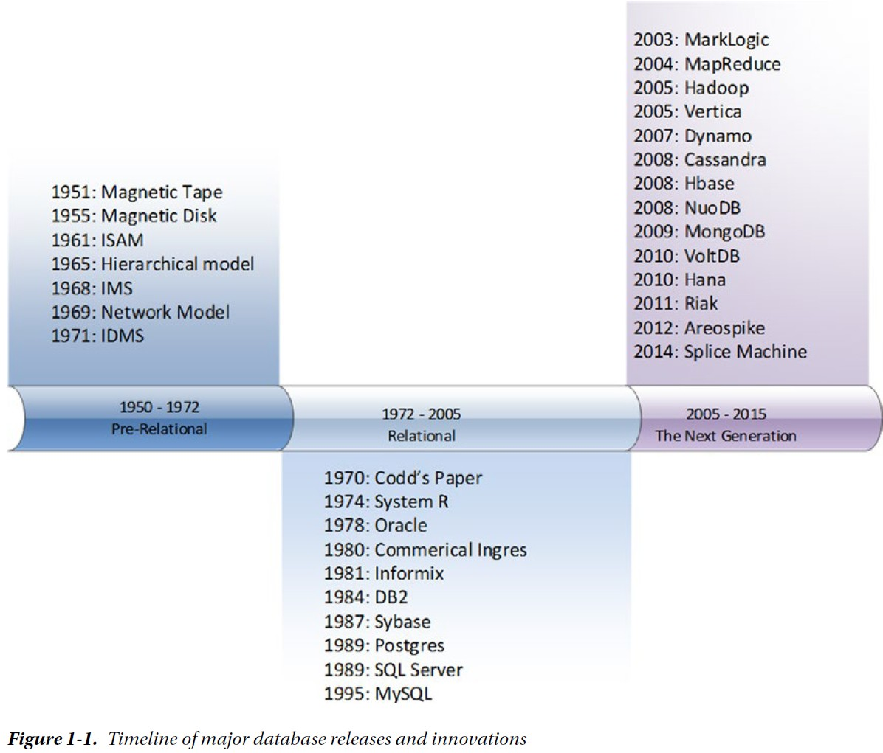
Three Database Revolutions
First revolution: driven by the emergence of the electronic computer
Second revolution: the emergence of the relational database.
Third revolution: due to an explosion of non-relational database alternatives driven by the demands of modern applications that require global scope and continuous availability.

Slide 3
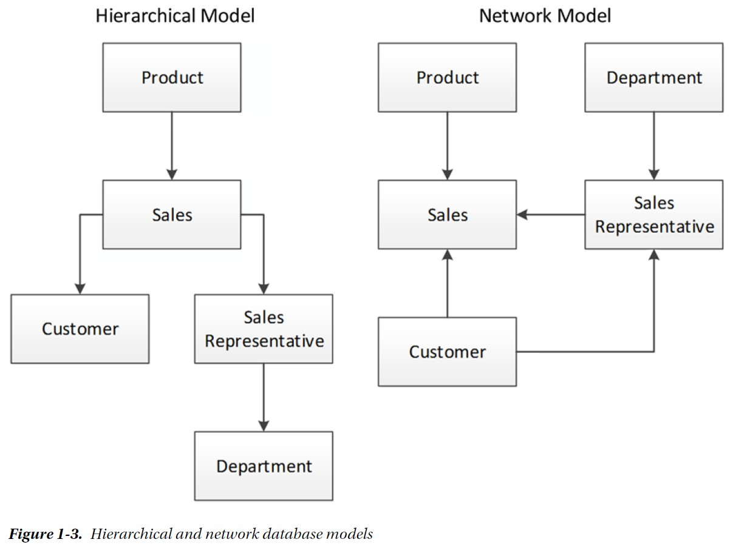
The First Database Revolution

Slide 4
The Second Database Revolution
Existing databases were too hard to use. Databases of the day could only be accessed by people with specialized programming skills.
Existing databases lacked a theoretical foundation. Codd’s mathematical background encouraged him to think about data in terms of formal structures and logical operations; he regarded existing databases as using arbitrary representations that did not ensure logical consistency or provide the ability to deal with missing information.
Existing databases mixed logical and physical implementations. The representation of data in existing databases matched the format of the physical storage in the database, rather than a logical representation of the data that could be comprehended by a nontechnical user.

Slide 5
The Second Database Revolution (continued)
Edgar Codd’s Relational Theory
Key concepts of the relational model include:
Tuples, an unordered set of attribute values. In an actual database system, a tuple corresponds to a row, and an attribute to a column value.
A relation, which is a collection of distinct tuples and corresponds to a table in relational database implementations.
Constraints, which enforce consistency of the database. Key constraints are used to identify tuples and relationships between tuples.
Operations on relations such as joins, projections, unions, and so on. These operations always return relations. In practice, this means that a query on a table returns data in a tabular format.

Slide 6
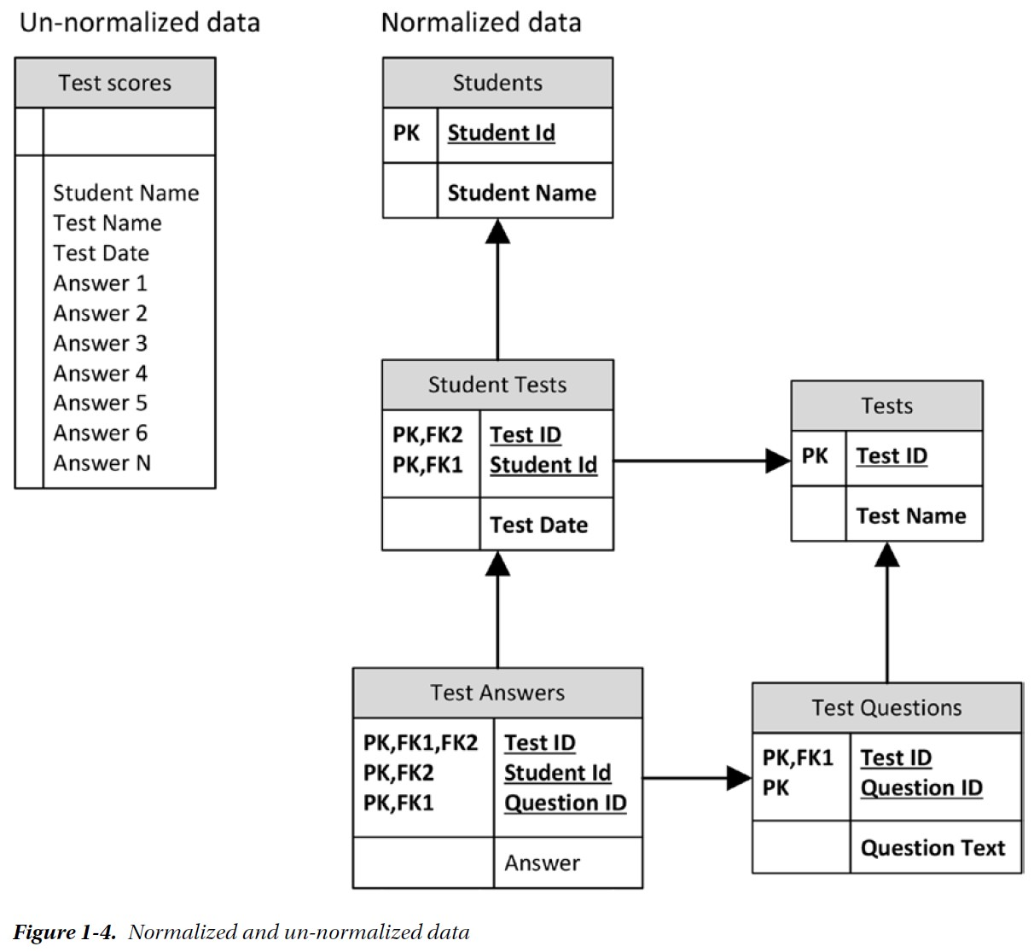
The Second Database Revolution (continued)

Slide 7
Transaction Model
Jim Gray's Transaction Model: A transaction is a transformation of state which has the properties of atomicity (all or nothing), durability (effects survive failures) and consistency (a correct transformation).
ACID transactions: Atomic, Consistent, Independent, and Durable. An ACID transaction should be:
Atomic: The transaction is indivisible—either all the statements in the transaction are applied to the database or none are.
Consistent: The database remains in a consistent state before and after transaction execution.
Isolated: While multiple transactions can be executed by one or more users simultaneously, one transaction should not see the effects of other in-progress transactions.
Durable: Once a transaction is saved to the database (in SQL databases via the COMMIT command), its changes are expected to persist even if there is a failure of operating system or hardware.

Slide 8
Object-Oriented Programming and the OODBMS
In traditional “procedural” programming languages, data and logic were essentially separate. Procedures would load and manipulate data within their logic, but the procedure itself did not contain the data in any meaningful way.
Object-oriented (OO) programming merged attributes and behaviors into a single object. So, for instance, an employee object might represent the structure of employee records as well as operations that can be performed on those records—changing salary, promoting, retiring, etc. Object-oriented programming represented a huge gain in programmer productivity, application reliability, and performance.

Slide 9
Object-Oriented Programming and the OODBMS (continued)
Two most relevant principles of object-oriented programming are:
Encapsulation: An object class encapsulates both data and actions (methods) that may be performed on that data. Indeed, an object may restrict direct access to the underlying data, requiring that modifications to the data be possible only via an objects methods. For instance, an employee class might include a method to retrieve salary and another method to modify salary. The salary-modification method might include restrictions on minimum and maximum salaries, and the class might allow for no manipulation of salary outside of these methods.
Inheritance: Object classes can inherit the characteristics of a parent class. The employee class might inherit all the properties of a people class (DOB, name, etc.) while adding properties and methods such as salary, employee date, and so on.

Slide 10
Object-Oriented Programming and the OODBMS (continued)
The object-oriented programming revolution (mid-1990s) set the stage for the first serious challenge to the relational database. Object-oriented developers were frustrated by what they saw as an impedance mismatch between the object-oriented representations of their data within their programs and the relational representation within the database.
In an object-0riented program, all the details relevant to a logical unit of work would be stored within the one class or directly linked to that class. For instance, a customer object would contain all details about the customer, with links to objects that contained customer orders, which in turn had links to order line items.
This representation was inherently non-relational; indeed, the representation of data matched more closely to the network databases of the CODASYL era. When an object was stored into or retrieved from a relational database, multiple SQL operations would be required to convert from the object-oriented representation to the relational representation. This was cumbersome for the programmer and could lead to performance or reliability issues. Figure 1-5 illustrates the problem.

Slide 11
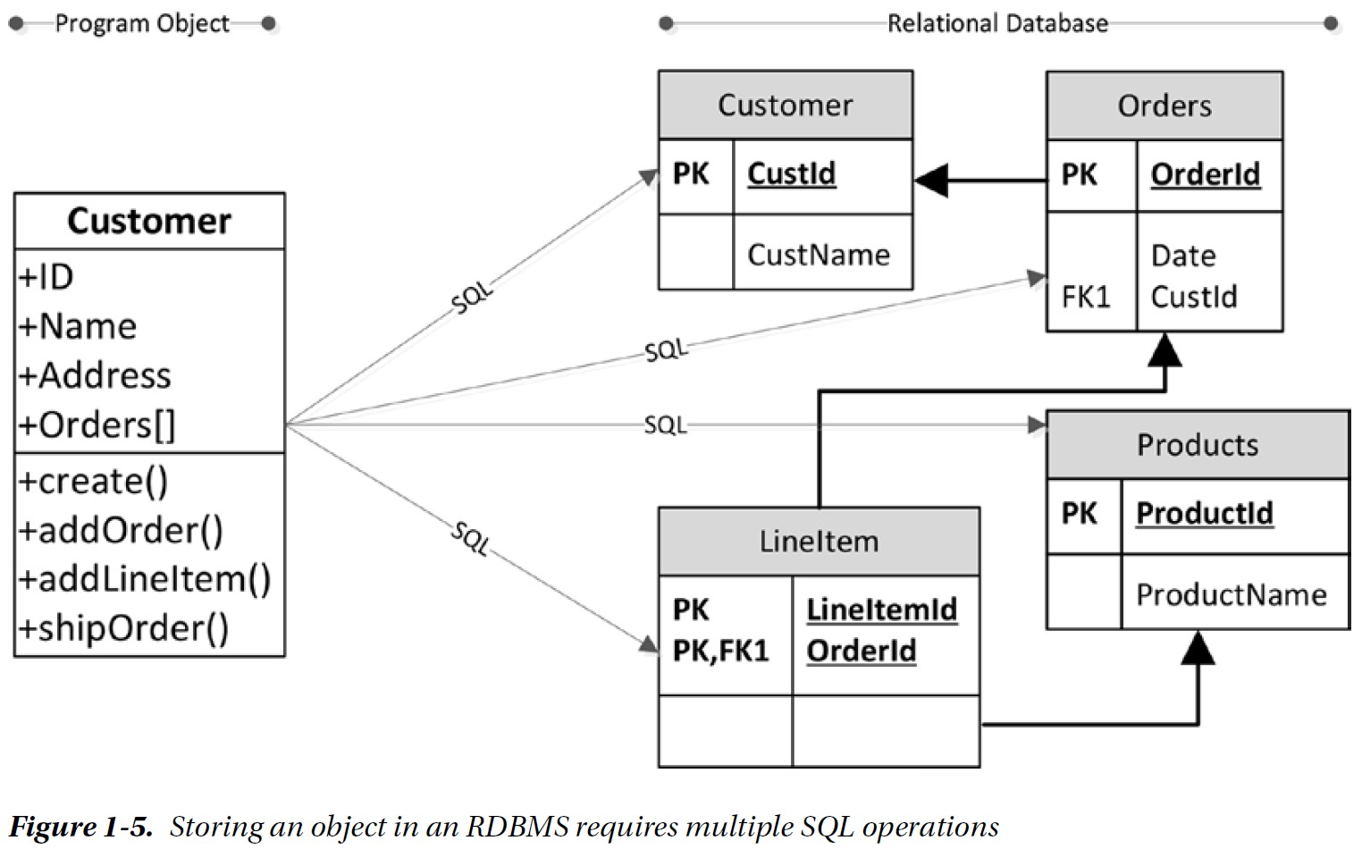
Object-Oriented Programming and the OODBMS (continued)

Slide 12
Object Oriented Database Management System (OODBMS)
The success of OO Programming led to the proposition that an Object Oriented Database Management System (OODBMS) was better suited to meet the demands of modern applications. An OODBMS would store program objects directly without normalization, and would allow applications to load and store their objects easily. In implementation, OODBMS resembles the navigational model from the pre-relational era—pointers within one object (a customer, for instance) would allow navigation to related objects (such as orders). Some OODBMS systems were developed and gained initial traction. However, by the end of the decade, OODBMS systems had completely failed to gain market share.
Why OODBMS failed? The advocates of the OODBMS model were concentrating on only the advantages an OODBMS offered to the application developer, and ignoring the disadvantages the new model had for those who wished to consume information for business purposes. Databases don’t exist simply for the benefit of programmers; they represent significant assets that must be accessible to those who want to mine the information for decision making and business intelligence. By implementing a data model that could only be used by the programmer, and depriving the business user of a usable SQL interface, the OODBMS failed to gain support outside programming circles.
OO programmers’ pain was somewhat alleviated by Object-Relational Mapping (ORM) frameworks that automated the most tedious aspects of the translation from objects to relational databases.

Slide 13
The Third Database Revolution: Google and Hadoop
In 2003, Google revealed details of the distributed file system GFS that formed a foundation for its storage architecture, and in 2004 it revealed details of the distributed parallel processing algorithm MapReduce, which was used to create World Wide Web indexes.
By 2005, the era of complete relational database supremacy was just about to end. The era of massive web-scale applications created pressures on the relational database. The relational database was inadequate to deal with the volumes and velocity of the data confronting Google. It had to invent new hardware and software architectures to store and process the exponentially growing quantity of websites it needed to index.
In 2006, Google revealed details about its BigTable distributed structured database.
These concepts, together with other technologies, many of which also came from Google, formed the basis for the Hadoop project, which matured within Yahoo! and which experienced rapid uptake from 2007 on. The Hadoop ecosystem more than anything else became a technology enabler for the Big Data ecosystem.

Slide 14
The Third Database Revolution: Amazon’s Dynamo
Websites dedicated to online e-commerce—Amazon, for example—had a need for a transactional processing capability that could operate at massive scale. MySpace and Facebook faced similar challenges in scaling their infrastructure from thousands to millions of users—even the most expensive commercial RDBMS such as Oracle could not provide sufficient scalability to meet the demands of these sites.
Sharding: partitioning the data across multiple databases based on a key attribute, such as the customer identifier.
Sharding at sites like Facebook has allowed a MySQL-based system to scale up to massive levels, but many relational operations and database-level ACID transactions are lost. It becomes impossible to perform joins or maintain transactional integrity across shards. The operational costs of sharding, together with the loss of relational features, made many seek alternatives to the RDBMS.
A dilemma within Amazon had resulted in development of an alternative model to strict ACID consistency within its homegrown data store. Amazon revealed details of this system, “Dynamo,” in 2008. Amazon’s Dynamo model, together with innovations from web developers seeking a “webscale” database, led to the emergence of what came to be known as key-value databases.

Slide 15
The Third Database Revolution: Cloud Computing
Between 2006 and 2008, Amazon rolled out Elastic Compute Cloud (EC2). EC2 made available virtual machine images hosted on Amazon’s hardware infrastructure and accessible via the Internet. EC2 could be used to host web applications, and computing power could be relatively rapidly added on demand.
Amazon added other services such as storage (S3, EBS), Virtual Private Cloud (VPC), a MapReduce service (EMR), etc. The entire platform was known as Amazon Web Services (AWS) and was the first practical implementation of an Infrastructure as a Service (IaaS) cloud. AWS became the inspiration for cloud computing offerings from Google, Microsoft, and others.
For applications wishing to exploit the elastic scalability allowed by cloud computing platforms, existing relational databases were a poor fit. The demand for elastically scalable databases accelerated the growth of key-value stores, often based on Amazon’s own Dynamo design. Amazon offered non-relational services in its cloud starting with SimpleDB, which eventually was replaced by DynamoDB.

Slide 16
The Third Database Revolution: Document Databases
Programmers continued to be unhappy with the impedance mismatch between object-oriented and relational models. Object relational mapping systems only relieved a small amount of the inconvenience that occurred when a complex object needed to be stored on a relational database in normal form.
JSON became the de facto format for storing—serializing—objects to disk. Some websites started storing JSON documents directly into columns within relational tables. It was only a matter of time before someone decided to eliminate the relational middleman and create a database in which JSON could be directly stored. These became known as document databases.
CouchBase and MongoDB are two popular JSON-oriented databases, though virtually all nonrelational databases—and most relational databases, as well—support JSON.
Programmers like document databases for the same reasons they liked OODBMS: it relieves them of the laborious process of translating objects to relational format.

Slide 17
The Third Database Revolution: “NewSQL”
In 2007, Michael Stonebraker and his team published a seminal paper “The End of an Architectural Era (It’s Time for a Complete Rewrite).” This paper pointed out that the hardware assumptions that underlie the consensus relational architecture no longer applied, and that the variety of modern database workloads suggested a single architecture might not be optimal across all workloads. Stonebraker and his team proposed a number of variants on the existing RDBMS design, each of which was optimized for a specific application workload.
Two of these designs became particularly significant: H-Store described a pure in-memory distributed database while C-Store specified a design for a columnar database. Both these designs were extremely influential in the years to come and are the first examples of what came to be known as NewSQL database systems—databases that retain key characteristics of the RDBMS but that diverge from the common architecture exhibited by traditional systems such as Oracle and SQL Server.

Slide 18
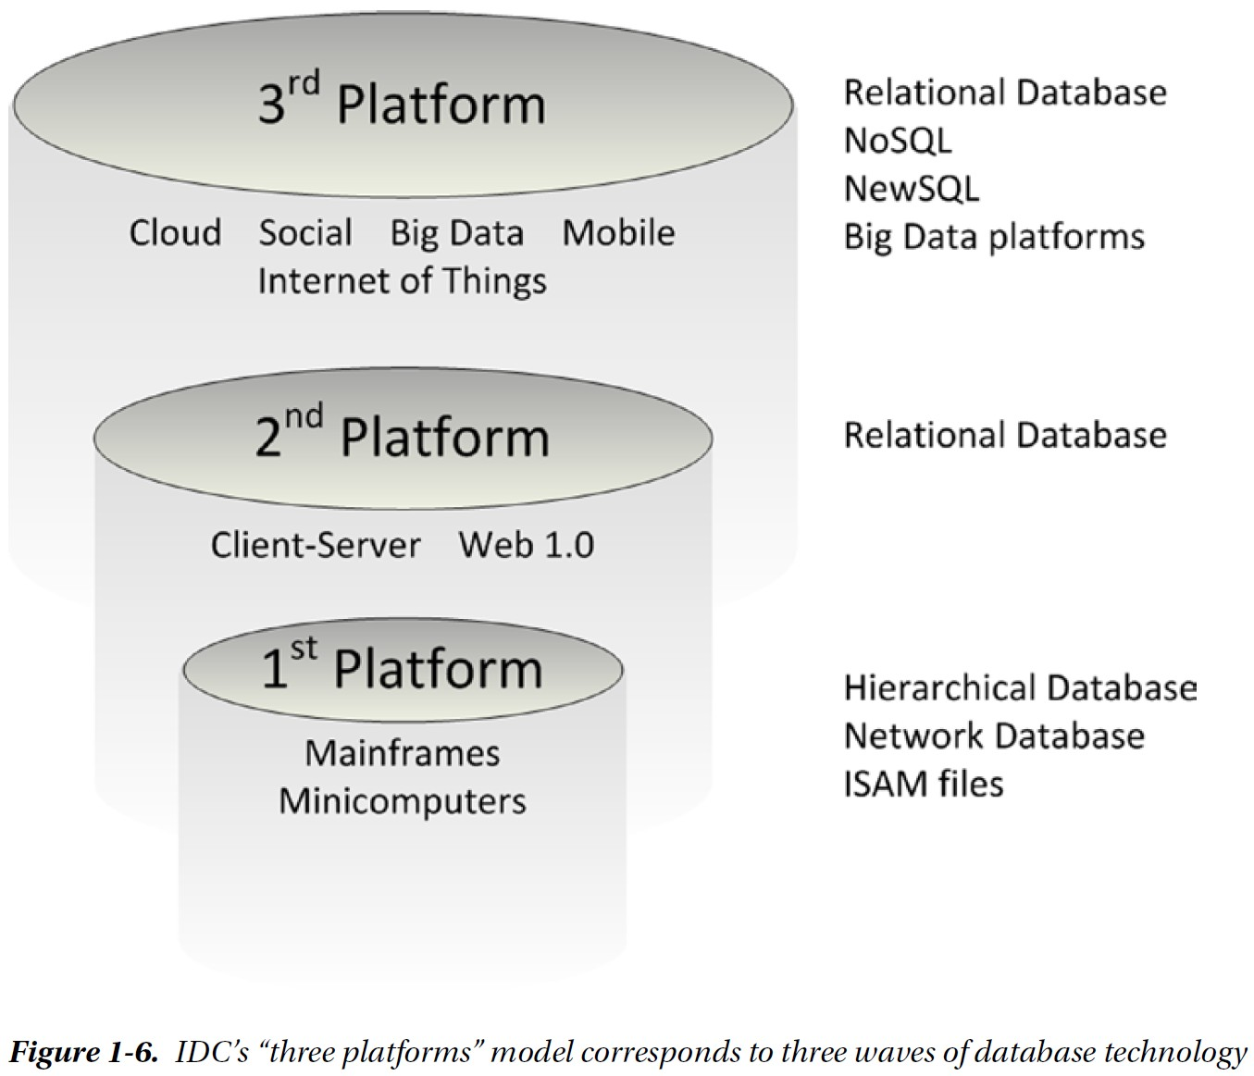
Three platforms correspond to Three Waves of Database Revolutions

Slide 19
Chapter 2: Google, Big Data and Hadoop

Slide 20
Cloud, Mobile, Social, and Big Data
The three leading information technology trends over the last decade have been in cloud, mobile, and social media. Consumers now found it convenient to shop online whenever the impulse arose. Retailers discovered that they could leverage information from social networks and other Internet sources to target marketing campaigns and personalize engagement.
The key to the effectiveness of the new retail model is data: the social-mobile-cloud generates masses of data that can be used to refine and enhance the online experience. This positive feedback loop drives the Big Data solutions that can represent success or failure for the next generation of retail operations.
Similar dynamics drive almost every other industry. The Internet of Things (IoT) — new connected devices such as Internet-enabled cars, wearable devices, home automation, and so on — propel the virtuous data cycle that generates and depends on data to drive competitive advantage.

Slide 21
Google: Pioneer of Big Data
When Google was first created in 1996, the World Wide Web was already a network of unparalleled scale. Existing search engines simply indexed on keywords within webpages. This was inadequate, given the sheer number of possible matches for any search term; the results were primarily weighted by the number of occurrences of the search term within a page, with no account for usefulness or popularity.
Google's PageRank allowed the relevance of a page to be weighted based on the number of links to that page, and it allowed Google to immediately provide a better search outcome than its competitors.
PageRank is a great example of a data-driven algorithm that leverages the “wisdom of the crowd” (collective intelligence) and that can adapt intelligently as more data is available (machine learning).
Google is, therefore, the first example of a company that succeeded on the web through what we now call data science.

Slide 22
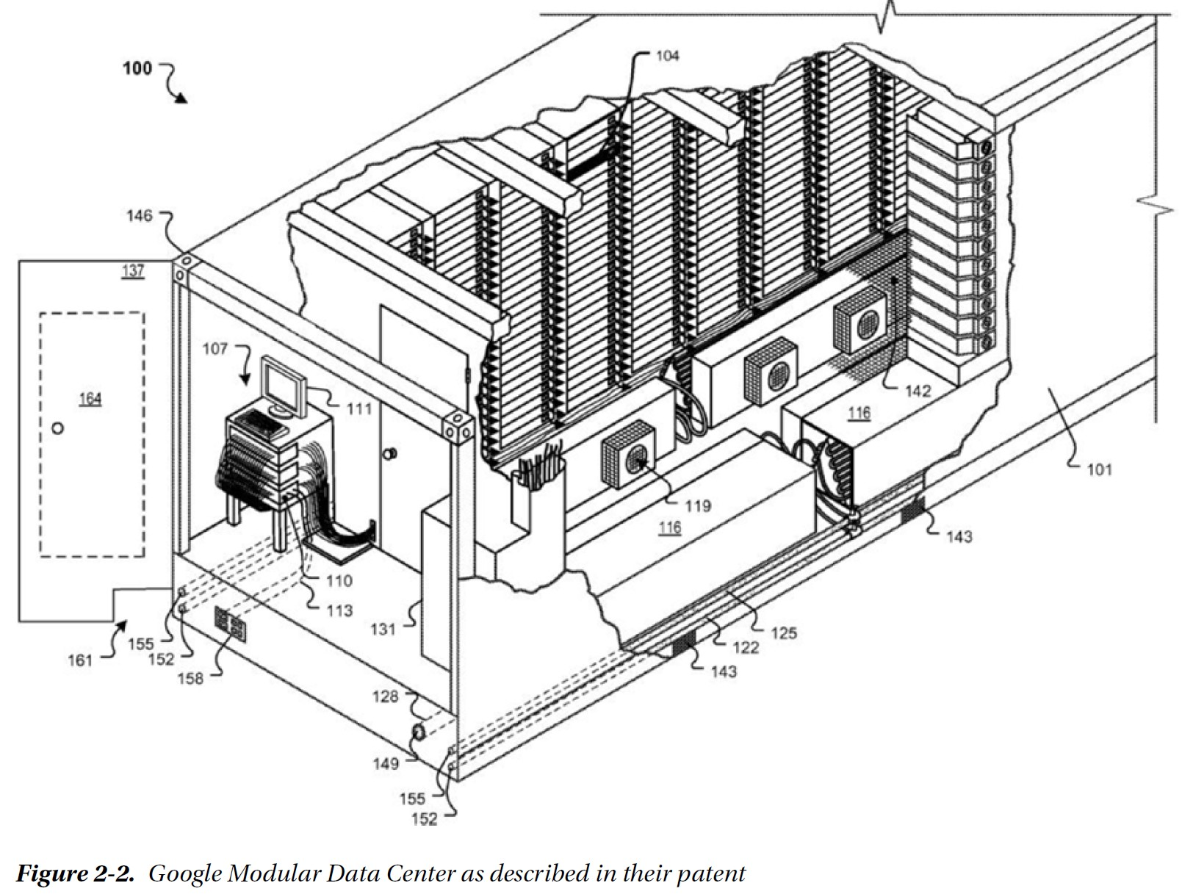
Google Hardware: Modular Data Center

Slide 23
The Google Software Stack
Google File System (GFS): a distributed cluster file system that allows all of the disks within the Google data center to be accessed as one massive, distributed, redundant file system.
MapReduce: a distributed processing framework for parallelizing algorithms across large numbers of potentially unreliable servers and being capable of dealing with massive datasets.
BigTable: a nonrelational database system that uses the Google File System for storage.

Slide 24
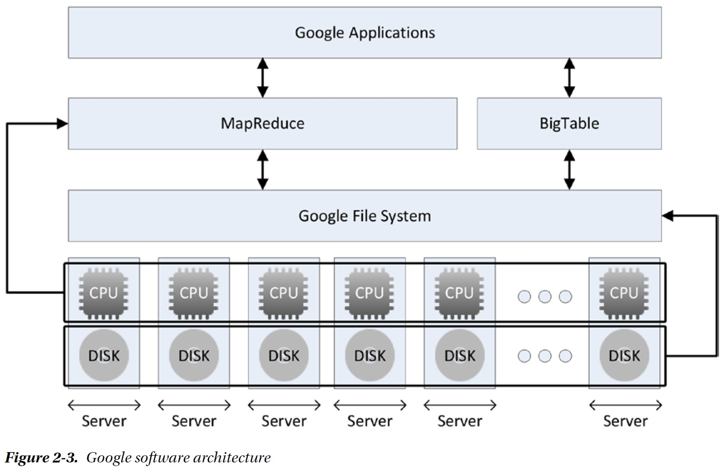
Google Software Architecture

Slide 25
MapReduce
MapReduce is a programming model for general-purpose parallelization of data-intensive processing. It divides the processing into two phases: a mapping phase, in which data is broken up into chunks that can be processed by separate threads—potentially running on separate machines; and a reduce phase, which combines the output from the mappers into the final result.
For example (see Figure 2-4 on the next slide), suppose we wish to count the occurrences of pet types in some input file. We break the data into equal chunks in the map phase. The data is then shuffled into groups of pet types. Finally, the reduce phase counts the occurrences to provide a total that is fed into the output.

Slide 26
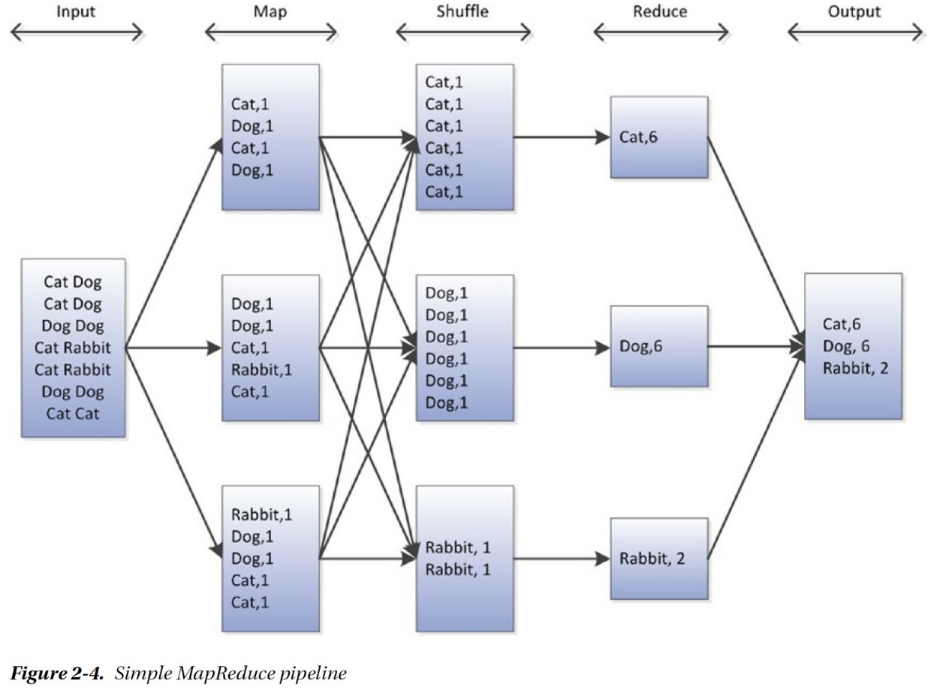
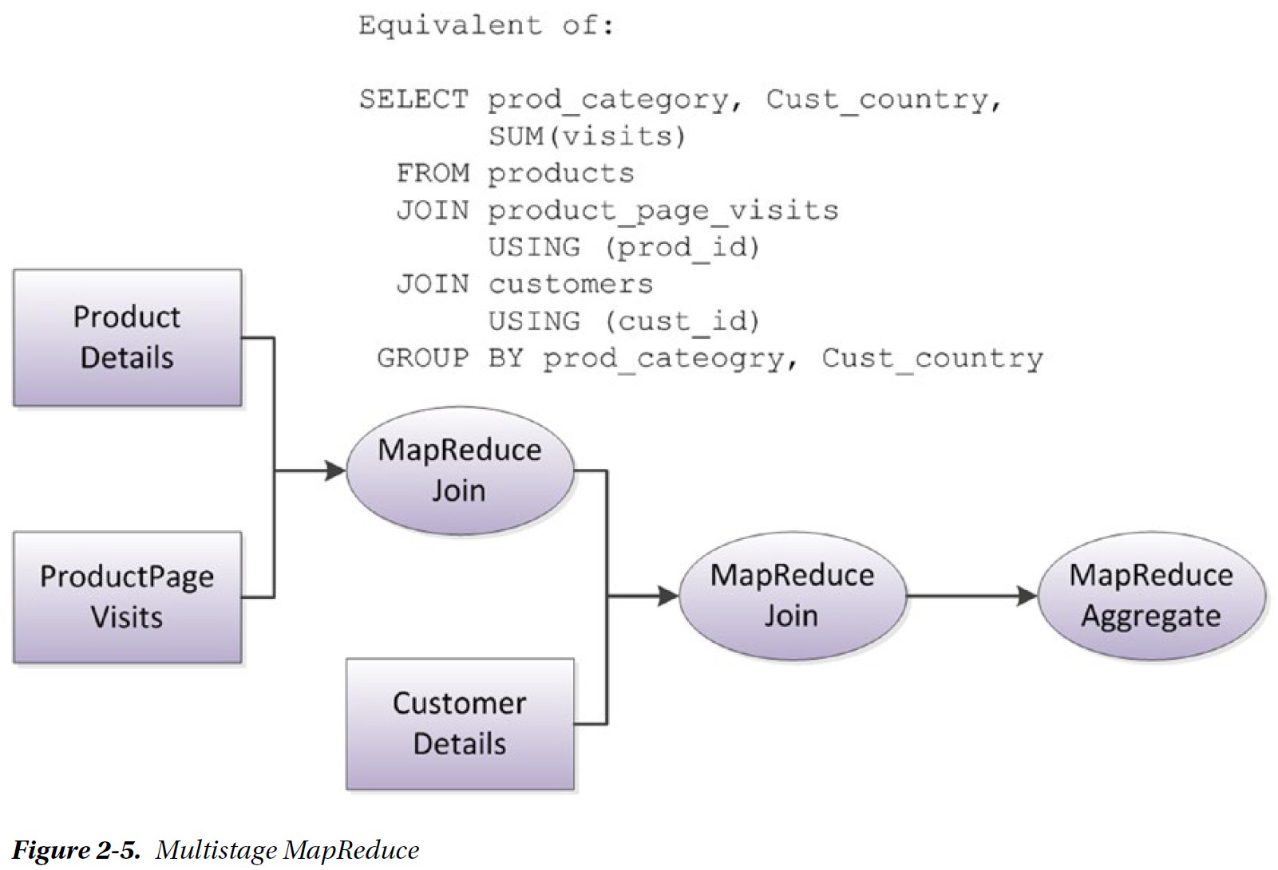
Sample MapReduce Pipelines

Slide 27
Hadoop: Open-Source Google Stack
Google technologies served as the inspiration for Hadoop, which contains analogs for each of these important technologies and which is available to all as an open source Apache project.
No other single technology has had as great an influence on Big Data as Hadoop. Hadoop, by providing an economically viable means of mass unstructured data storage and processing, has bought Google-style Big Data processing within the reach of mainstream IT.

Slide 28
Hadoop (continued)
Hadoop was made available for download in 2007, and became a top-level Apache project in 2008.
In early 2008, Yahoo! announced that a Hadoop cluster with over 5 petabytes of storage and more than 10,000 cores was generating the index that resolved Yahoo!’s web searches.
Facebook started experimenting with Hadoop in 2007, and by 2008 it had a cluster utilizing 2,500 CPU cores in production. Facebook’s initial implementation of Hadoop supplemented its Oracle-based data warehouse. By 2012, Facebook`s Hadoop cluster had exceeded 100 petabytes of disk, and it had completely overtaken Oracle as a data warehousing solution, as well as powering many core Facebook products.
Most organizations that are actively pursuing a Big Data solution use Hadoop in some form.
By 2012, each of IT giants (Microsoft, Oracle, and IBM) had ceased to offer any form of Hadoop alternative and instead were offering Hadoop within its product portfolio.

Slide 29
The Power of Hadoop
Hadoop provides an economically attractive storage solution for Big Data, as well as a scalable processing model for analytic processing:
An economical scalable storage model. As data volumes increase, so does the cost of storing that data online. Because Hadoop can run on commodity hardware that in turn utilizes commodity disks, the price point per terabyte is lower than that of almost any other technology.
Massive scalable IO capability. Because Hadoop uses a large number of commodity devices, the aggregate IO and network capacity is higher than that provided by dedicated storage arrays in which smaller numbers of larger disks are provided by even smaller numbers of processors. Moreover, adding new servers to Hadoop adds storage, IO, CPU, and network capacity all at once, whereas adding disks to a storage array might simply exacerbate a network or CPU bottleneck within the array.

Slide 30
The Power of Hadoop (continued)
Reliability: Data in Hadoop is stored redundantly in multiple servers and can be distributed across multiple computer racks. Failure of a server does not result in a loss of data; in fact, a Hadoop job will continue even if a server fails—the processing simply switches to another server.
A scalable processing model: MapReduce represents a widely applicable and scalable distributed processing model. While MapReduce is not the most efficient implementation for all algorithms, it is capable of brute-forcing acceptable performance for almost all.
Schema on read: Data can be loaded into Hadoop without having to be converted to a highly structured normalized format. This makes it easy for Hadoop to quickly ingest data from various forms. The imposition of structure can be delayed until the data is accessed; this is sometimes referred to as schema on read, as opposed to the schema on write mode of relational data warehouses.

Slide 31
Hadoop’s Architecture
Hadoop’s architecture uses Hadoop Distributed File System (HDFS), which is similar to Google File System (GFS).
There are currently two major iterations of Hadoop architecture. Hadoop 2.0 layers on top of the 1.0 architecture.
In Hadoop 1.0, the majority of servers in a Hadoop cluster function both as data nodes and as task trackers, which is to say that each server supplies both data storage and processing capacity (CPU and memory).
Specialized nodes within the Hadoop 1.0 architecture are also defined. The job tracker node coordinates the scheduling of jobs run on the Hadoop cluster, while the name node is a sort of directory that provides the mapping from blocks on data nodes to files on HDFS.
Every piece of data will usually be replicated across three nodes, which can be located on separate server racks to avoid any single point of failure.

Slide 32
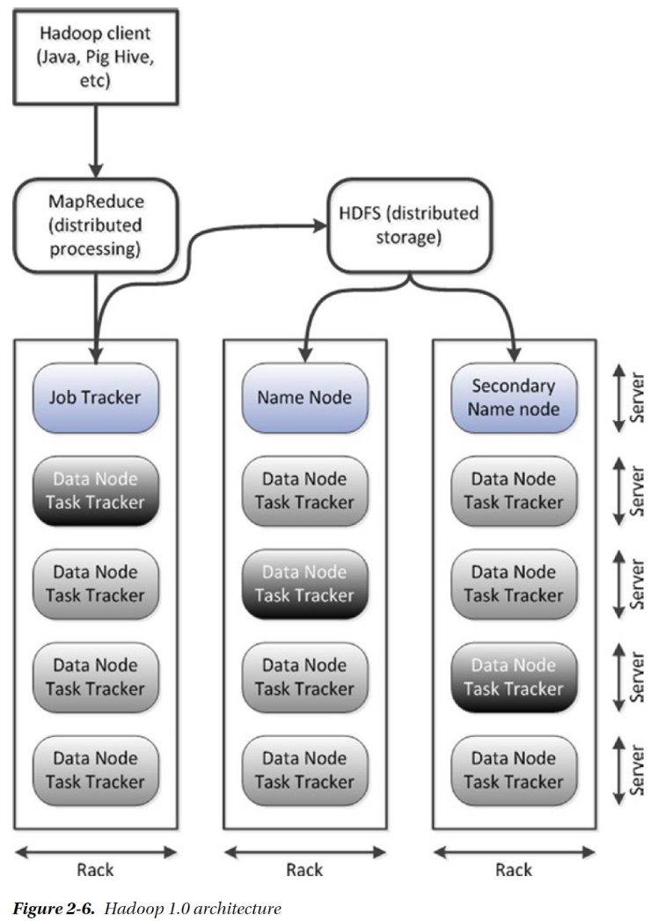
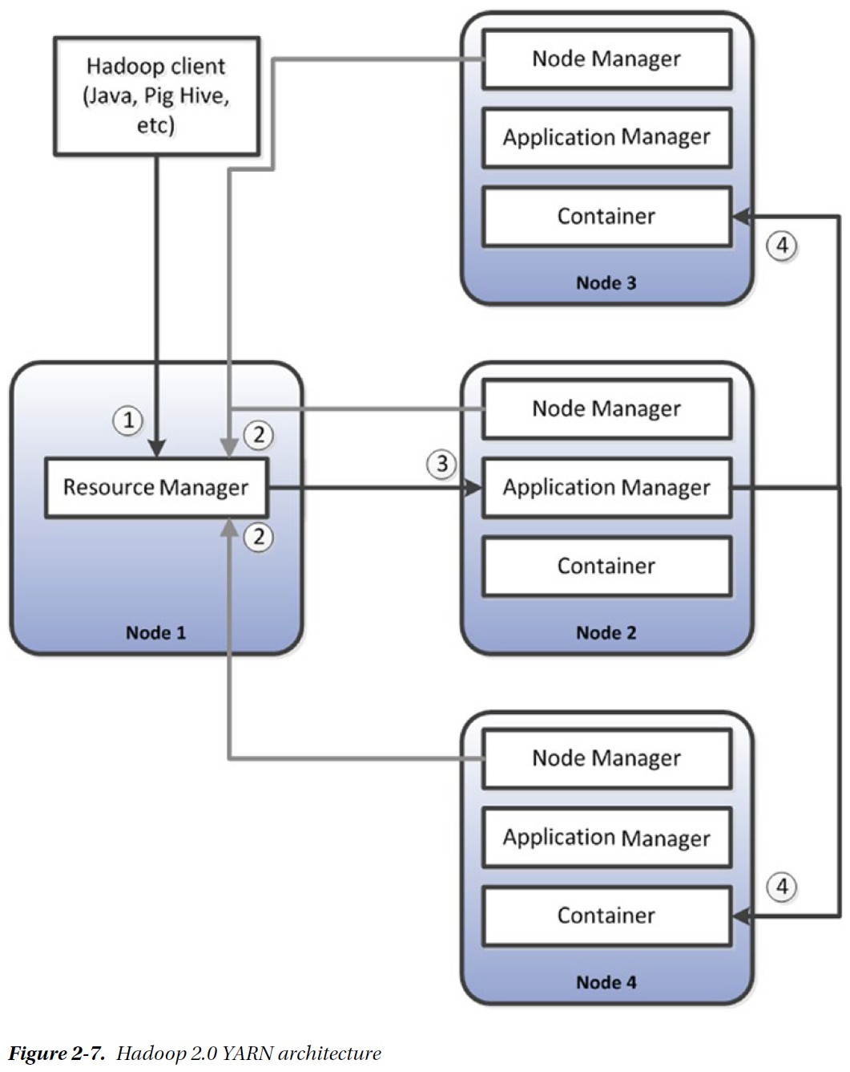
Hadoop Architectures

Slide 33
HBase
HBase uses Hadoop HDFS as a file system. By using Hadoop HDFS as its file system, HBase is able to create tables of truly massive size — way beyond the possible size for a system like MySQL, or even for Oracle.
Because each data item in an HDFS file system is replicated (by default) three times, HDFS provides automatic redundancy for HBase tables. Since HDFS provides this inherent redundancy, HBase need not store multiple copies of data to protect against data loss.
The terminology of HBase objects seem pretty familiar — columns, rows, tables, keys. However, HBase tables are significantly different from the relational tables with which we are familiar: First, in each cell — a column value for a particular row — there will usually be multiple versions of a data value. Each version of data within a cell is identified by a timestamp. This provides HBase tables with a sort of temporal “third dimension.” Second, HBase columns are more like the key values in key:value pairs than the fixed and relatively small number of columns found in a relational database table.
Each row can have a huge number of “sparse” columns. Each row in an HBase table can appear to consist of a unique set of columns.

Slide 34
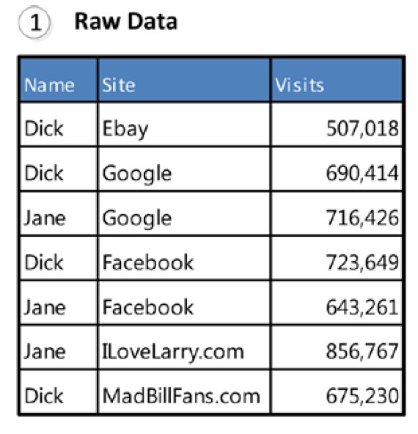
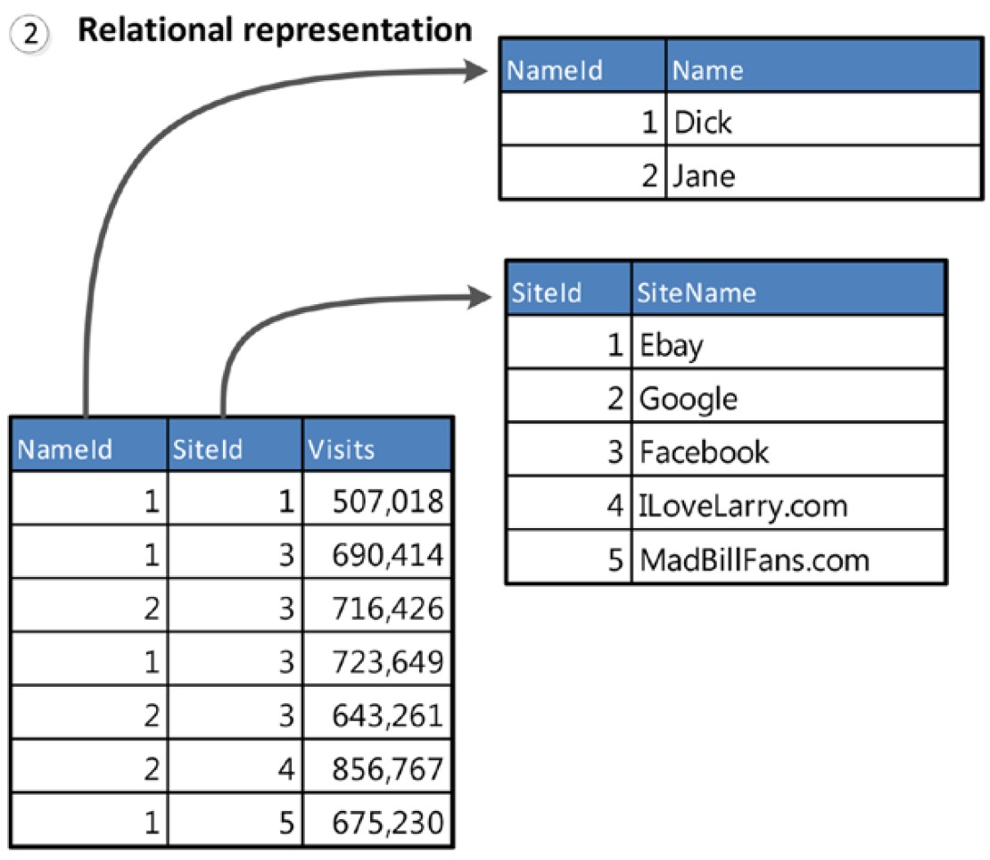
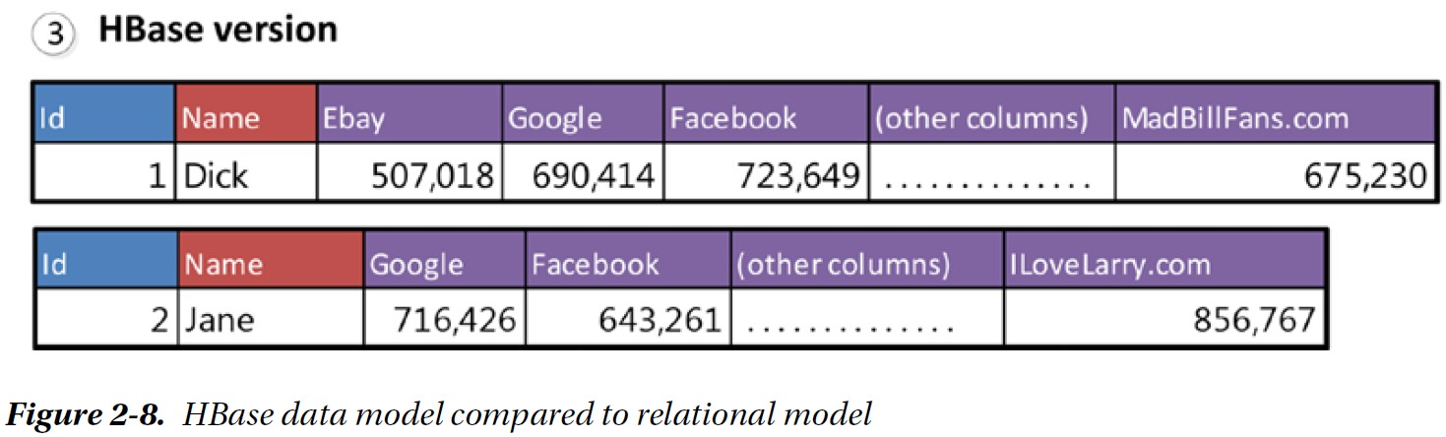
HBase Data Model

Slide 35
Hive
The full value of the platform could not be realized if only people capable of coding MapReduce programs could access the system. Non-programmers needed flexible, powerful, and accessible query tools to extract data from the Hadoop system. Even for programmers, the laborious and tedious process of coding MapReduce to perform repetitive reporting tasks seemed terribly inefficient. Two solutions to this problem were independently developed at Facebook and Yahoo!: Hive and Pig.
Hive is usually thought of as “SQL for Hadoop”. The Hive metadata service contains information about the structure of registered files in the HDFS file system. This metadata “schematizes” these files, providing definitions of column names and data types. The Hive client or server accepts SQL-like commands called Hive Query Language (HQL). These commands are translated into Hadoop jobs that process the query and return the results to the user. Most of the time, Hive creates MapReduce programs that implement query operations such as joins, sorts, aggregation, and so on.
Hive opened up Hadoop to anybody familiar with SQL; thus, Hadoop could operate as a form of data warehouse, and set the stage for integration of Hadoop into Business Intelligence tools. However, Hadoop’s batch orientation means that even the simplest HQL query cannot run in a real-time mode.

Slide 36
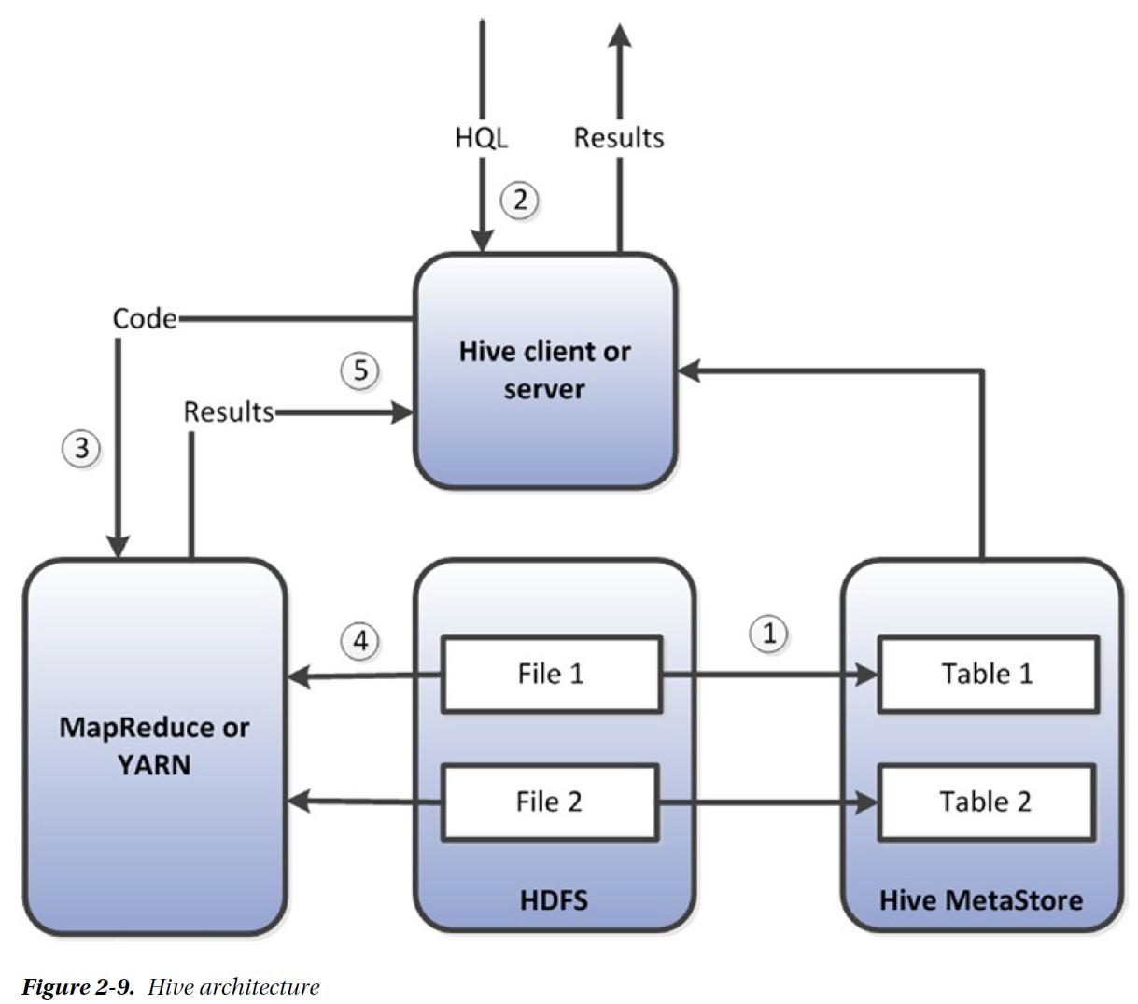
Hive Architecture

Slide 37
Pig
Pig supports a procedural, high-level data flow language called Pig Latin.
Like Hive, Pig Latin is compiled to MapReduce code. However, Pig is more of a scripting language than a SQL alternative.
While it is possible to create Pig equivalents to virtually all Hive HQL queries, Pig is capable of expressing far more complex pipelines of operations than is HQL.

Slide 38
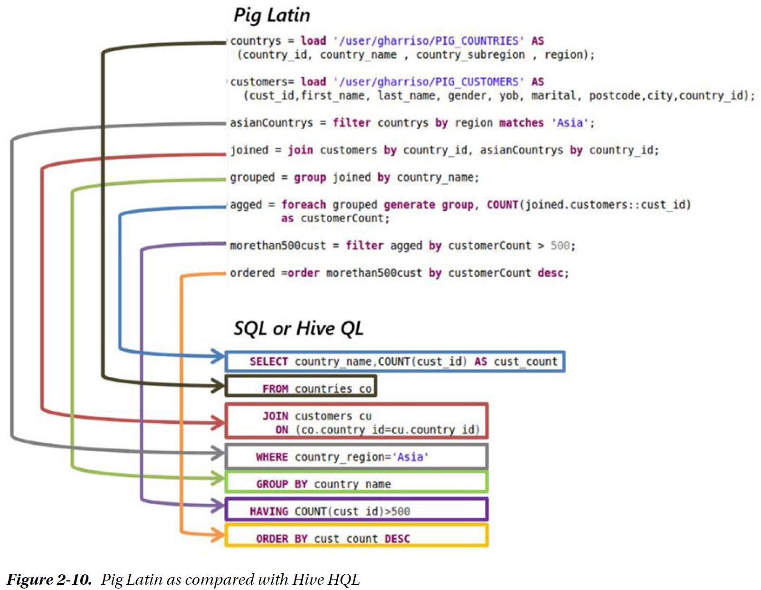
Pig Latin as Compared with Hive HQL

Slide 39
The Hadoop Ecosystem
MapReduce, YARN, and HDFS represent the foundations of the Hadoop architecture. HBase, Pig, and Hive are built on top of those foundations.
The Hadoop ecosystem includes an ever expanding family of utilities and applications built on top of or designed to work with core Hadoop. Some of the most significant are:
Flume: a utility for loading file-based data into HDFS.
SQOOP: a utility for exchanging data with relational databases, either by importing relational tables into HDFS files or by exporting HDFS files to relational databases.
Zookeeper: provides coordination and synchronization services within the cluster.
Oozie: a workflow scheduler that allows complex workflows to be constructed from lower level jobs (for instance, running a Sqoop or Flume job prior to a MapReduce application).
Hue, a graphical user interface that simplifies Hadoop administrative and development tasks.

Slide 40
Chapter 3: Sharding, Amazon, and the Birth of NoSQL

Slide 41
Web 1.0 and Web 2.0
The World Wide Web was conceived and implemented as a global collection of linked static documents, often referred to as Web 1.0. The World Wide Web of dynamically created content with transactional capability is referred to as Web 2.0.
Early websites that wanted to provide some form of user interaction used the Common Gateway Interface (CGI), which allowed an HTTP request to invoke a script that would connect to a database and generate HTML code on the fly based on database contents. In this way, a website could display a catalog based on data held within a database.

Slide 42
Web 1.0 and Web 2.0 (continued)
CGI-based approaches gave way to more elegant frameworks such as Java J2EE and ASP.NET, though many websites based on the PHP language still follow the CGI model.
Regardless of the framework employed, the common pattern involved a web application server displaying information dynamically generated from database content.
A bottleneck in the web server layer can be fixed simply by adding more web servers. There can be as many web servers as you like communicating with a single back-end database.
However, fixing bottlenecks at the database layer was not so simple. While a few database clustering solutions were available, it was generally difficult to achieve linear scalability with these solutions, and none had ever demonstrated scalability at the level required by the larger e-commerce sites.

Slide 43
Web 1.0 and Web 2.0 (continued)
During the early stages of Web 2.0, the solution to database performance was simply to buy a more powerful (and expensive) database server. Two factors led to the abandonment of this scale-up solution:
The dot.com crash. The surviving web companies needed financially prudent solutions. Businesses wanted a solution that could start small and grow as required.
As Web 2.0 companies reached global scale, they found that even the most massive centralized database server could not meet their needs. Scaling up had run out of steam. Moreover, even if the scale-up solution had delivered the capacity required, it still represented a potential single point of failure, and it could not provide equitable response time across a global market.

Slide 44
Web 1.0 and Web 2.0 (continued)
During the early stages of Web 2.0, the solution to database performance was simply to buy a more powerful (and expensive) database server. Two factors led to the abandonment of this scale-up solution:
The dot.com crash. The surviving web companies needed financially prudent solutions. Businesses wanted a solution that could start small and grow as required.
As Web 2.0 companies reached global scale, they found that even the most massive centralized database server could not meet their needs. Scaling up had run out of steam. Moreover, even if the scale-up solution had delivered the capacity required, it still represented a potential single point of failure, and it could not provide equitable response time across a global market.

Slide 45
The Open-source Solution
Following the dot.com crash, open-source software such as Linux, Apache, and MySQL became increasingly valued within Web 2.0 operations.
MySQL is far less scalable than Oracle. However, Web developers came up with a couple of tricks to get MySQL to go further:
Using an open-source technology called Memcached to avoid database access as much is possible. Object-oriented languages could cache an object-oriented representation of database information across many Memcached servers. By reading from these servers rather than the database, the load on the database could be reduced.
Using MySQL replication. Replication allows changes to one database to be copied to another database. Read requests could be directed to any one of these replica databases. Write operations still had to go to the master database. However, in a typical web enabled database application, reads significantly outnumber writes, so the read replication strategy makes sense.

Slide 46
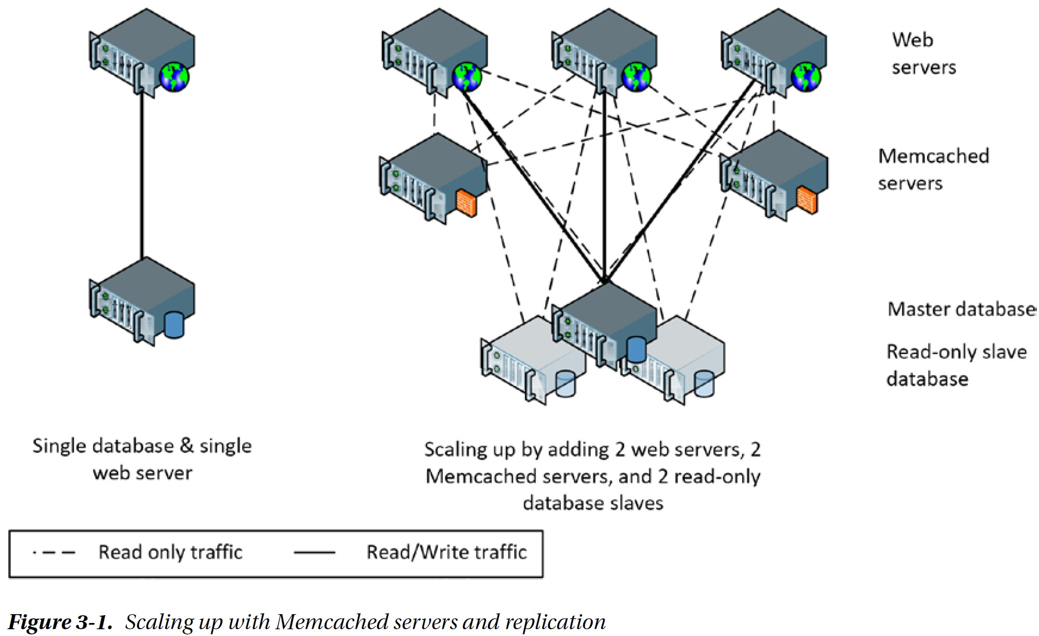
Scaling up with Memcached and Replication

Slide 47
Sharding
Memcached and read replication increase the overall capacity of MySQL-based web applications dramatically. However, they can only increase the read capability of the system. When the system reaches a bottleneck on database write activity, another solution (sharding) is required.
Sharding allows a logical database to be partitioned across multiple physical servers. In a sharded application, the largest tables are partitioned across multiple database servers. Each partition is referred to as a shard. This partitioning is based on a Key Value, such as a user ID. When operating on a particular record, the application must determine which shard will contain the data and then send the SQL to the appropriate server.
Sharding is a solution used at several large websites such as Facebook and Twitter. At both of these websites, data that is specific to an individual user is concentrated in MySQL tables on a specific node.

Slide 48
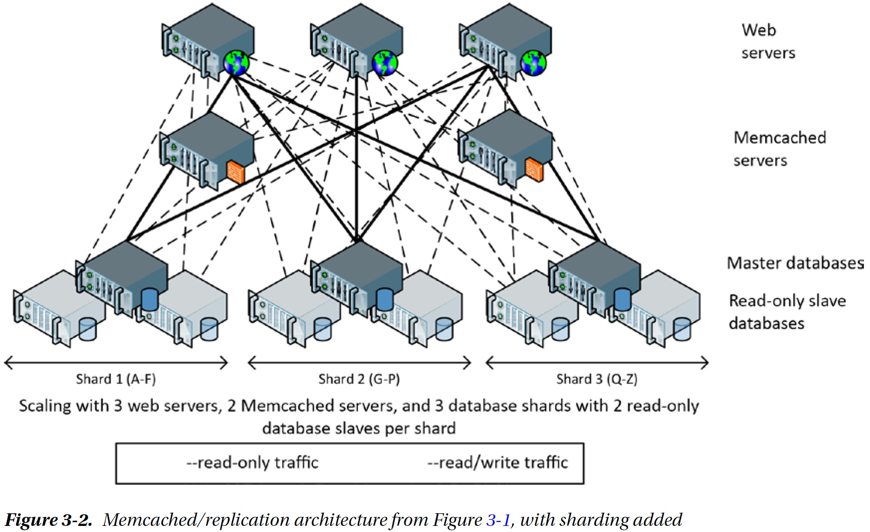
Sharding (continued)

Slide 49
Sharding (continued)
In around 2011, Facebook revealed that they were using more than 4,000 shards of MySQL and 9,000 Memcached servers in their configuration. This configuration supported 1.4 billion peak reads per second, 3.5 million row changes per second, and 8.1 million physical IOs per second.
Sharding is simple in concept but complex in practice. The application must contain logic that understands the location of any particular piece of data and the logic to route requests to the correct shard. Moreover, sharding is usually associated with rapid growth, so this routing needs to be dynamic. Requests that can only be satisfied by accessing more than one shard need complex coding too, whereas on a non-sharded database a single SQL statement might suffice.

Slide 50
Death by a Thousand Shards
Sharding (together with caching and replication) is arguably the only way to scale a relational database to massive web use. However, the operational costs of sharding are huge:
Application complexity. It’s up to the application code to route SQL requests to the correct shard. In a statically sharded database, this would be hard enough; however, most massive websites are adding shards as they grow, which means that a dynamic routing layer must be implemented. This layer is often in addition to complex code being required to maintain Memcached object copies and to differentiate between the master database and read-only replicas.
Crippled SQL. In a sharded database, it is not possible to issue a SQL statement that operates across shards. This usually means that SQL statements are limited to row level access. Joins across shards cannot be implemented, nor can aggregate GROUP BY operations. This means, in effect, that only programmers can query the database as a whole.
Loss of transactional integrity. ACID (Atomicity, Consistency, Isolation, Durability) transactions against multiple shards are not possible—or at least not practical.
Operational complexity. Load balancing across shards becomes extremely problematic. Adding new shards requires a complex rebalancing of data. Changing the database schema also requires a rolling operation across all the shards, resulting in transitory inconsistencies in the schema. In short, a sharded database entails a huge amount of operational effort and administrator skill.

Slide 51
CAP Theorem
In 2000, Eric Brewer outlined the “CAP” theorem, which states that any networked shared-data system can have at most two of three desirable properties:
consistency (C) equivalent to having a single up-to-date copy of the data
high availability (A) of that data (for updates)
tolerance to network partitions (P)
In 2000, the issue of partition tolerance was somewhat theoretical. Most systems resided in a single data center, and redundant network connectivity within that data center prevented any partition from ever occurring. If the data center failed, perhaps a failover data center would be bought online. But as web systems became global in scope and aspired to continual availability, partition tolerance became a real issue.

Slide 52
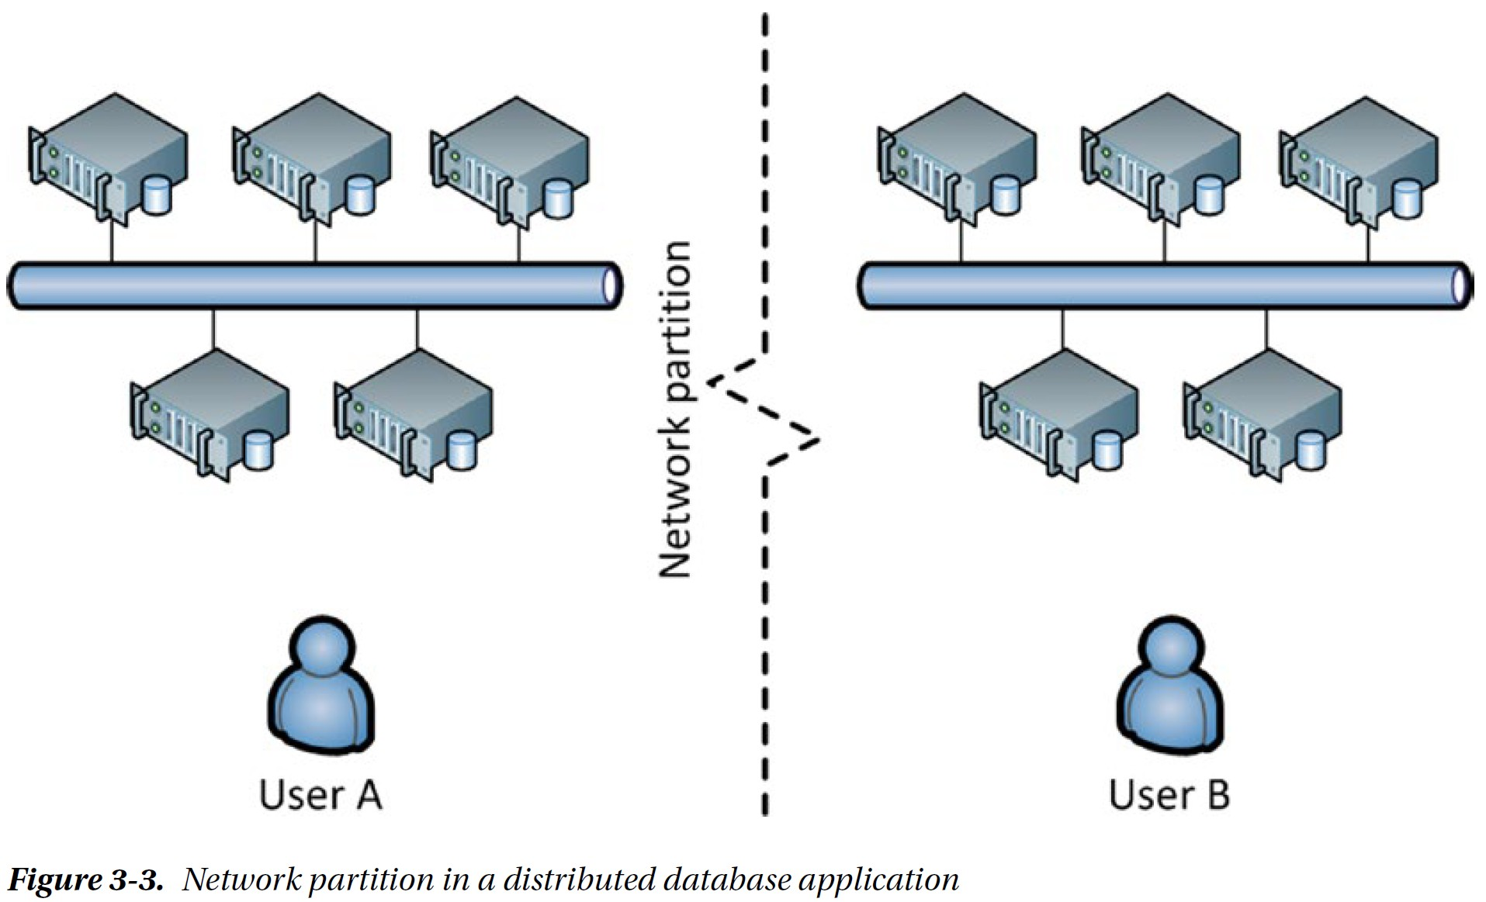
Network Partition in a Distributed Database Application
Oracle’s RAC (Real Application Clusters) scalable solution, which supported the ACID transactional model, would choose consistency: in the event of a network partition (“split brain”), one of the partitions would choose to shut down.
But, in the context of a global social network application, or a worldwide e-commerce system, the desired solution is to maintain availability even if some consistency between users is sacrificed.

Slide 53
Eventual Consistency
In any highly available database system, multiple copies of each data element must be maintained in order to allow the system to continue operating in the event of node failure. It is desirable to distribute nodes around the world to reduce latency in various locations. To ensure strict consistency, it becomes necessary that a database change is propagated to multiple nodes synchronously and immediately. When one of those nodes is far away, this creates an unavoidable increase in latency.
For banks, this latency penalty is unavoidable. However, for many websites, including social networks and certain e-commerce operations, this worldwide synchronous consistency is unnecessary. It doesn’t matter if my friend in Australia can see my tweet a few seconds before my friend in America. As long as both friends can see the tweet eventually, I’m happy.
This concept of eventual consistency has become a key characteristic of many NoSQL databases. The concept was most notably outlined by Werner Vogels, CTO of Amazon, and was implemented in Amazon’s Dynamo key-value store.

Slide 54
Amazon’s Dynamo
In 2007, Amazon introduced an alternative non-relational system, named Dynamo, to address the requirements of their massive online website. It was built with the following requirements in mind (Amazon was willing to compromise on a lot of features of existing databases in order to achieve these goals):
Continuous availability: The data store had to remain available under all foreseeable circumstances.
Network partition tolerant: a network partition should not force a loss of availability, even if that loss of availability was isolated to a particular geography.
No-loss conflict resolution: no order or shopping cart update should ever be lost. So for instance, if the user added items to his or her shopping cart from two different computers, both items should show up in the final cart.
Efficiency: The system needed to respond quickly, since online customers were notoriously impatient.
Economy: This system needed to be able to run on commodity hardware.
Incremental scalability: It should be possible to grow the system by adding servers in small increments without manual maintenance or downtime.

Slide 55
Amazon’s Dynamo (continued)
In Dynamo, the data store should relax consistency (within limits) if necessary in order to ensure availability. The phrase “within limits” means that the system should favor availability over consistency, but in a predictable, controllable, and manageable way.
The trade-off between consistency and availability should be configurable — the application should be able to choose what happens if there is a network partition, for instance.
The data store need only support primary key-based access and need not support a data model: the values retrieved by a key lookup would be unstructured binary objects. Unlike Google’s BigTable, which had the design goal of storing massive files, the assumption for Dynamo was that most objects would be small—under 1 MB.
Dynamo attempted to achieve a different outcome in terms of CAP theorem. Rather than try to always achieve consistency at the expense of network partition tolerance, Dynamo would allow (though not require) consistency to be sacrificed instead.

Slide 56
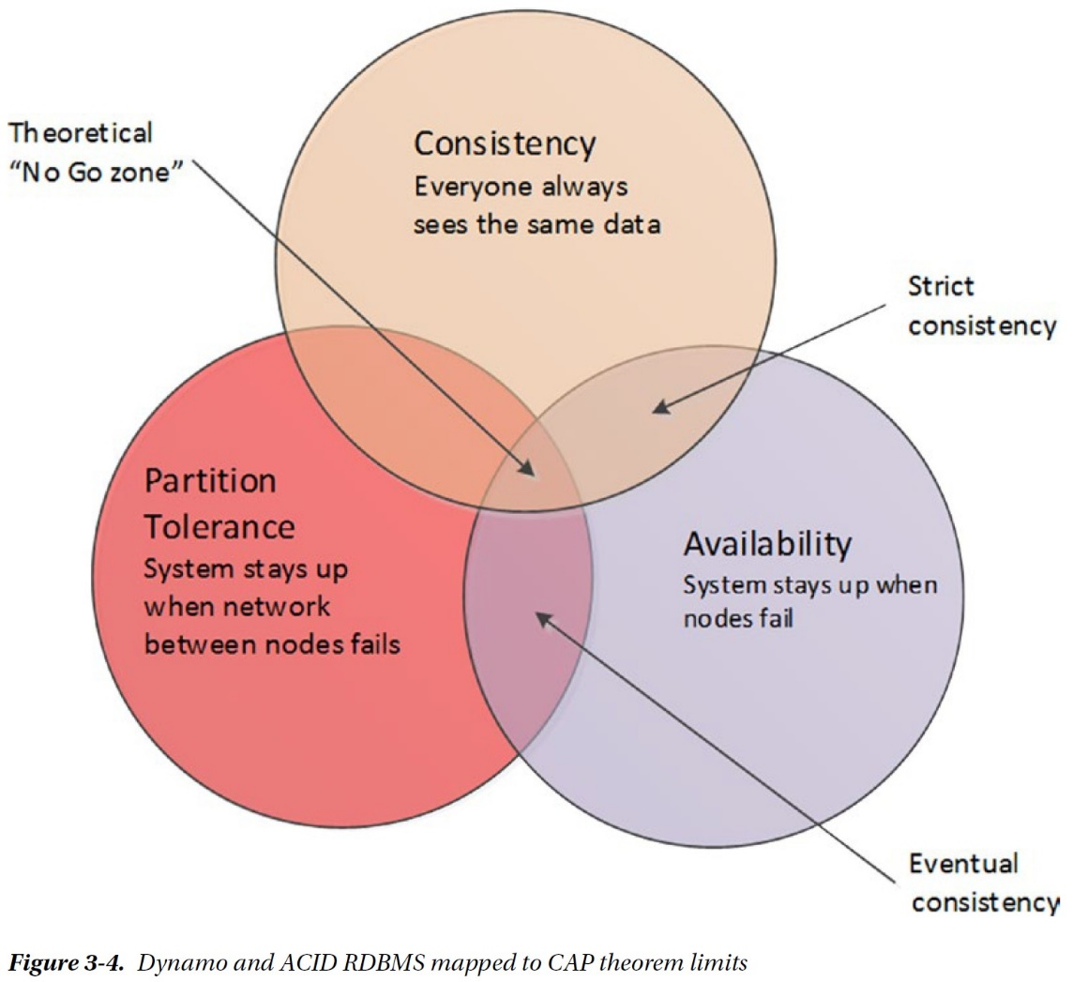

Slide 57
Amazon’s Dynamo (continued)
Some of the key architectural characteristics of Dynamo include:
Consistent hashing: Consistent hashing is a scheme that uses the hash value of the primary key to determine the nodes in the cluster responsible for that key and that allows nodes to be added or removed from the cluster with minimal rebalancing overhead.
Tunable consistency: The application can specify trade-offs between consistency, read performance, and write performance. It is possible in Dynamo to specify strong consistency, eventual consistency, or weak consistency.
Data versioning: Since write operations will never be blocked, it is possible that there will be multiple versions of an object in the system. Sometimes these can be merged by the data store itself, but sometimes they will need to be resolved by the application or user. For instance, if the buyer updates his or her shopping cart from two computers, the resulting cart may have duplicate items that he or she may need to remove.

Slide 58
Consistent Hashing
When we hash a key value, we perform a mathematical computation on the key value and use that computed value to determine where to store the data. One reason to use hashing is so that we are able to evenly distribute the data across a certain number of slots.
The most simple example of hashing is to use the modulo function, which returns the remainder of a division. If we want to hash any number into 10 buckets, we can use modulo 10; then key 27 would map to bucket 7, key 32 would map to bucket 2, key 25 to bucket 5, and so on. Using this method, we could map keys evenly across 10 servers.
Hashing works great as a way of distributing data evenly across a fixed number of nodes. But we have a problem if we add or remove a node — we have to recalculate the hash values and redistribute all the data. For instance, if we wanted to add a new server in the modulo 10 example above, we would recalculate hashes using modulo 11 and then we would have to move almost every data item accordingly.
Consistent hashing works by hashing key values and applying a consistent method for allocating those hashed values to specific nodes.

Slide 59
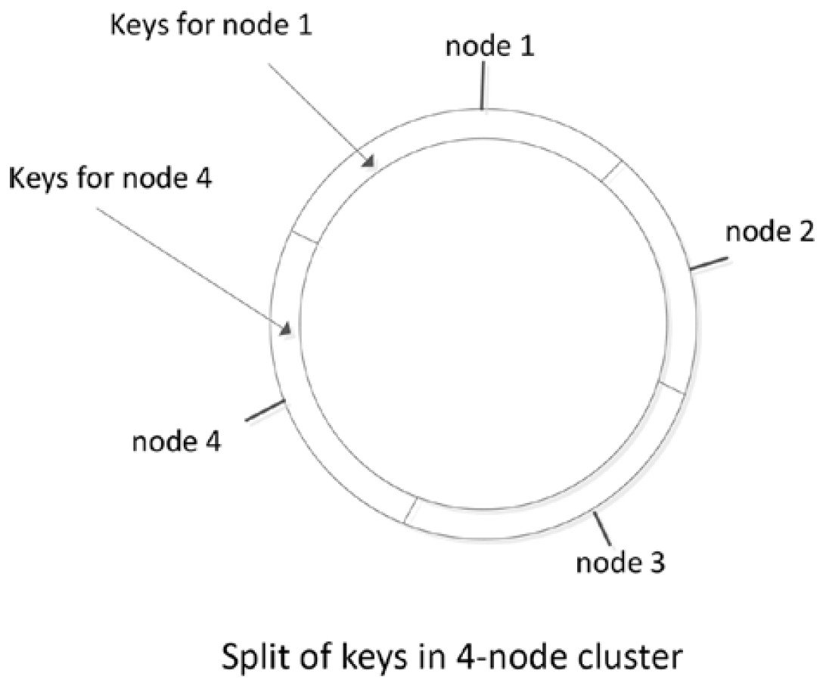
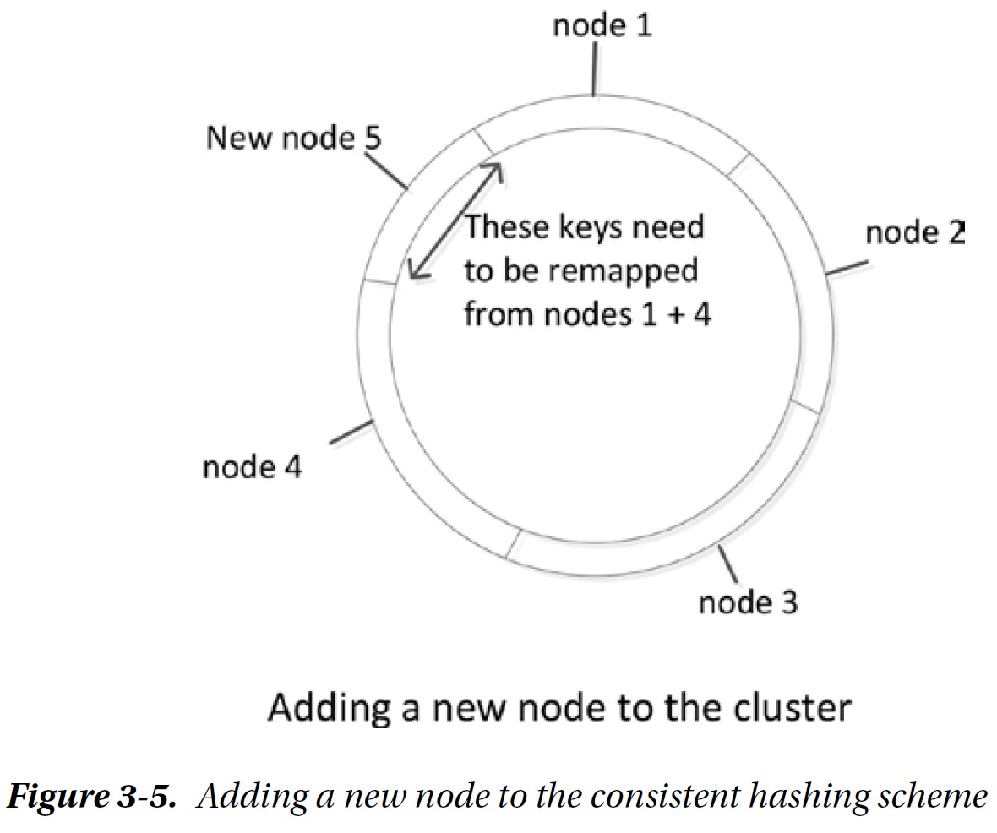

Slide 60
Tunable Consistency
Dynamo allows the application to choose the level of consistency applied to specific operations. NWR notation describes how Dynamo will trade off consistency, read performance, and write performance:
N is the number of copies of each data item that the database will maintain.
W is the number of copies of the data item that must be written before the write can complete.
R is the number of copies that the application will access when reading the data item.
When W = N, Dynamo will always write every copy before returning control to the application—this is what ACID databases do when implementing synchronous replication. If the application is more concerned about write performance than read performance, then set W = 1, R = N. Then each read must access all copies to determine which is correct, but each write only has to touch a single copy of the data before returning control (other writes propagate to all copies as a background task).
The most common configuration is N > W > 1. More than one write must complete, but not all nodes need to be updated immediately. Another common setting is W + R > N; this ensures that the latest value will always be included in a read operation, even if it is mixed in with “older” values. This is sometimes referred to as quorum assembly.

Slide 61
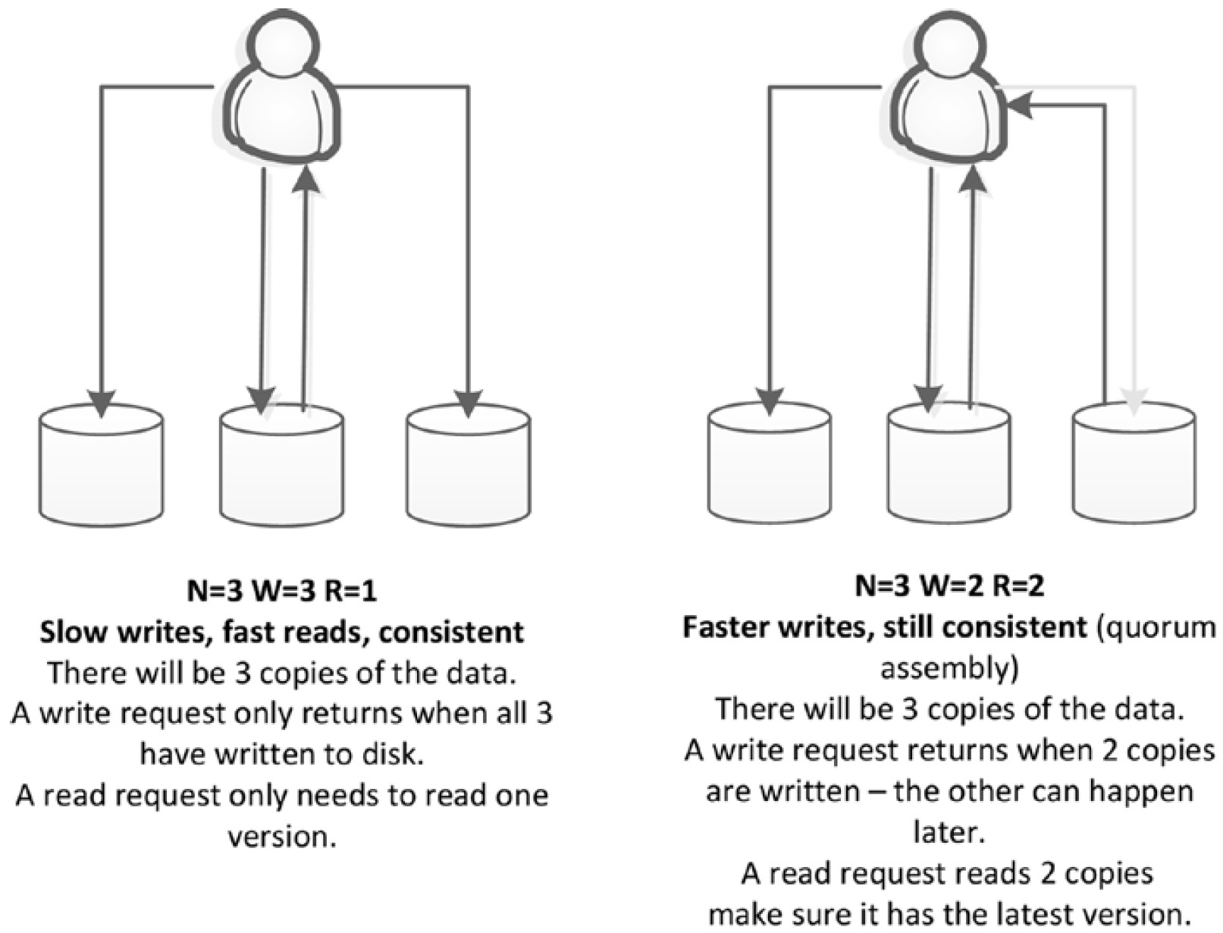
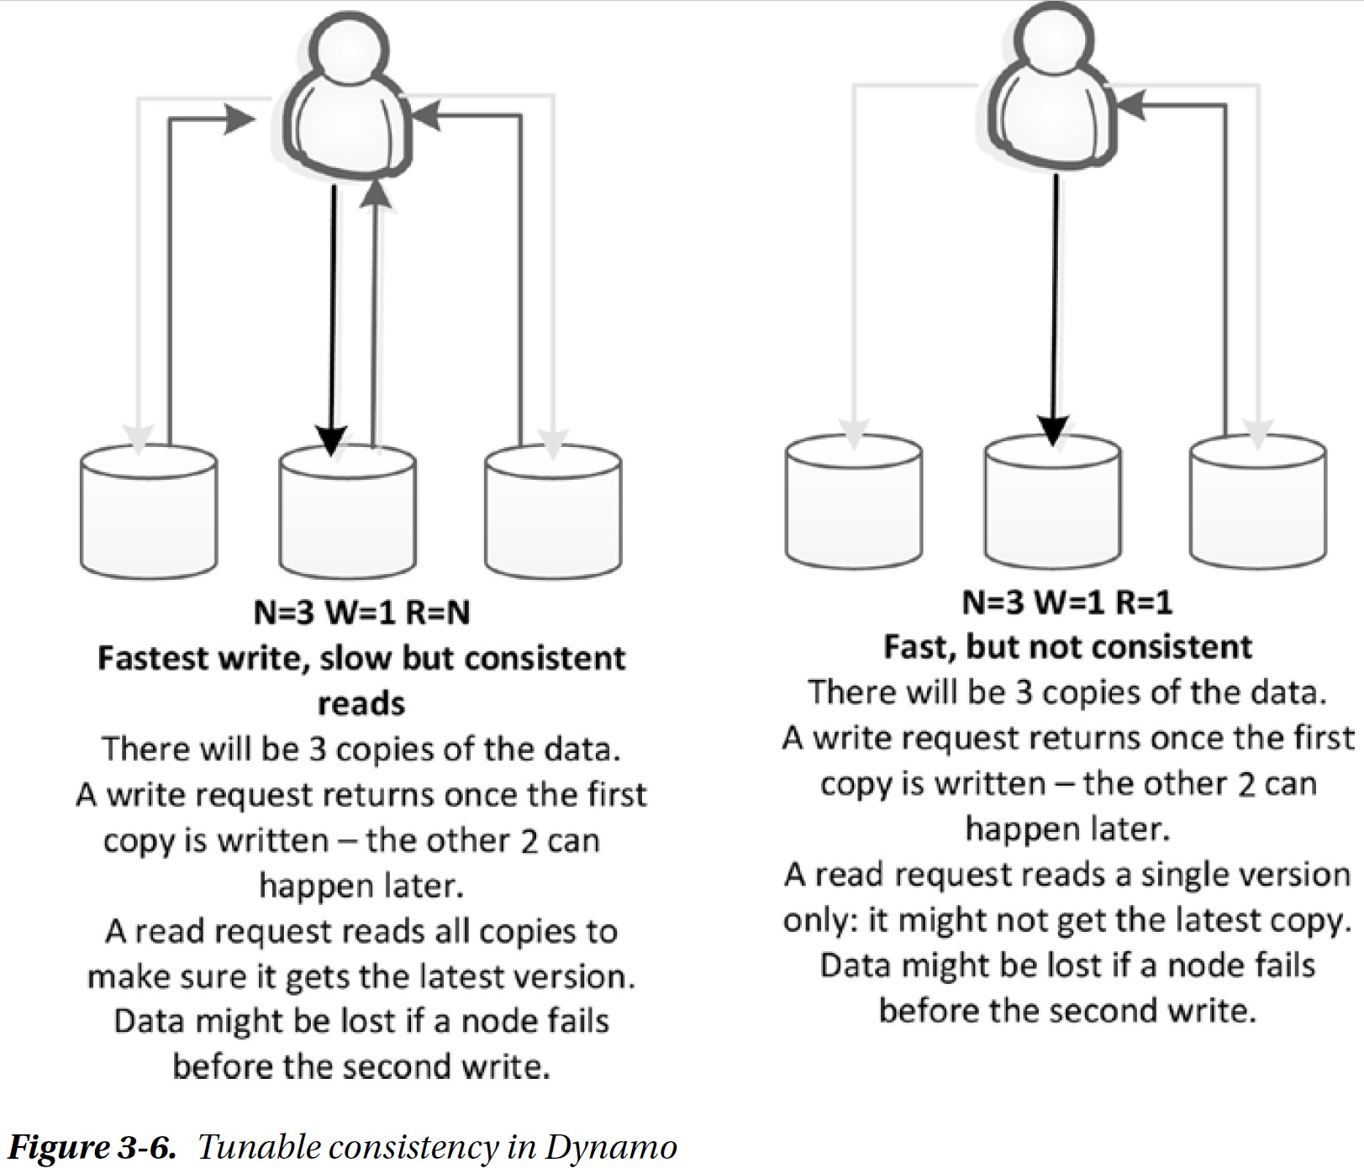
Tunable Consistency Examples

Slide 62
Dynamo and the Key-value Store Family
Systems that implement one of the primary characteristics of Dynamo became generically known as key–value stores. Just as Google’s GFS and MapReduce papers became the blueprint for Hadoop, Amazon’s Dynamo paper became the blueprint for many key-value stores.
Dynamo-inspired systems were the first recognizable NoSQL databases: Riak, LinkedIn’s Voldemort, Cassandra, and Amazon’s own DynamoDB.
Riak and Voldemort are more or less exact copies of the Dynamo architecture; while others use Dynamo in conjunction with other concepts. For instance, Apache’s Cassandra implements Dynamo’s consistent hashing and tunable consistency models, combined with a variation on the BigTable data model.
Although Dynamo represents the most popular and well-articulated key-value store architecture, there are certainly key-value stores that owe little or nothing to the Dynamo design. These include systems such as Redis and Oracle NoSQL.

